Slide 1
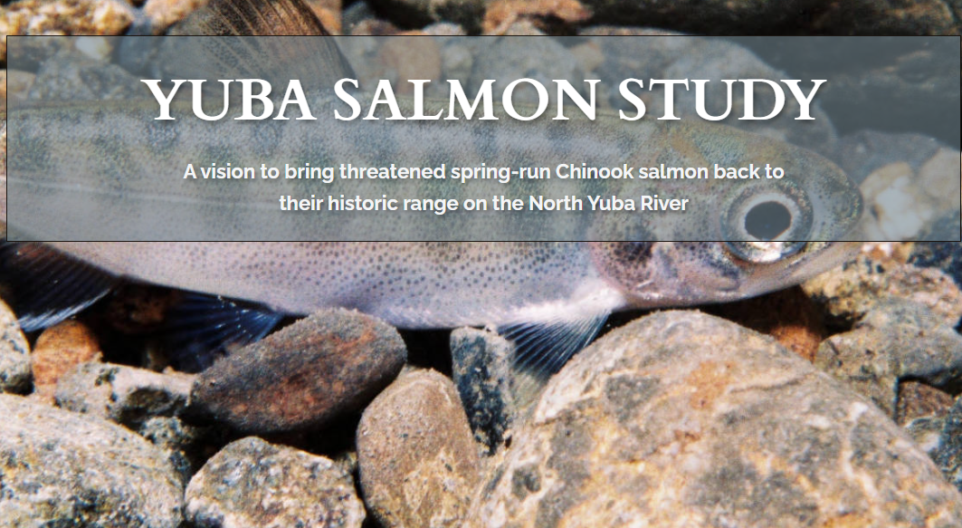
Welcome!

Slide 2
Land Acknowledgement
The Yuba River watershed is on the Ancestral and Traditional homelands of the Nisenan, and includes shared boundaries with the Mountain Maidu, Konkow, and Washoe peoples. These nations have lived here for millennia and live here still.
We acknowledge and mourn the painful history of genocide and the devastation of lands and waters irreversibly altered. We are grateful for opportunities to partner with Indigenous peoples to create a shared vision and rebalance our relationship to this place.

Slide 3
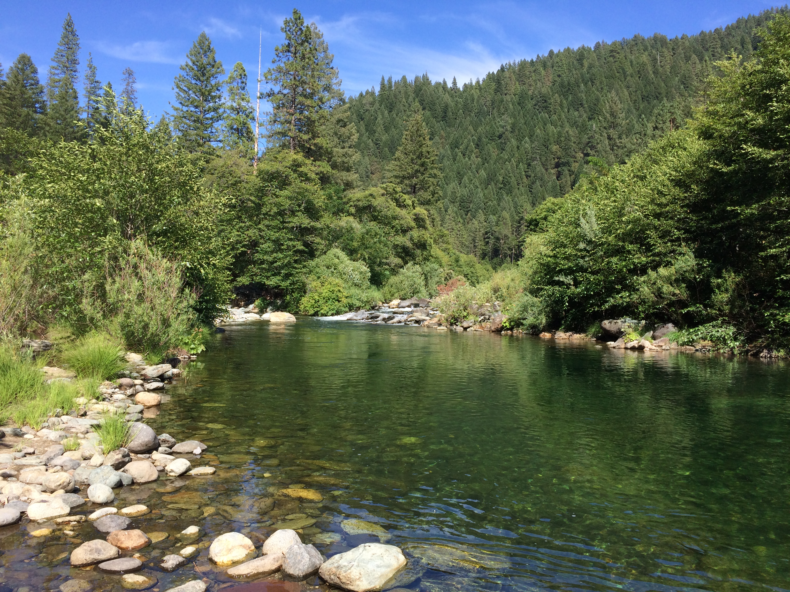



What is the Yuba Salmon Study?

Slide 4
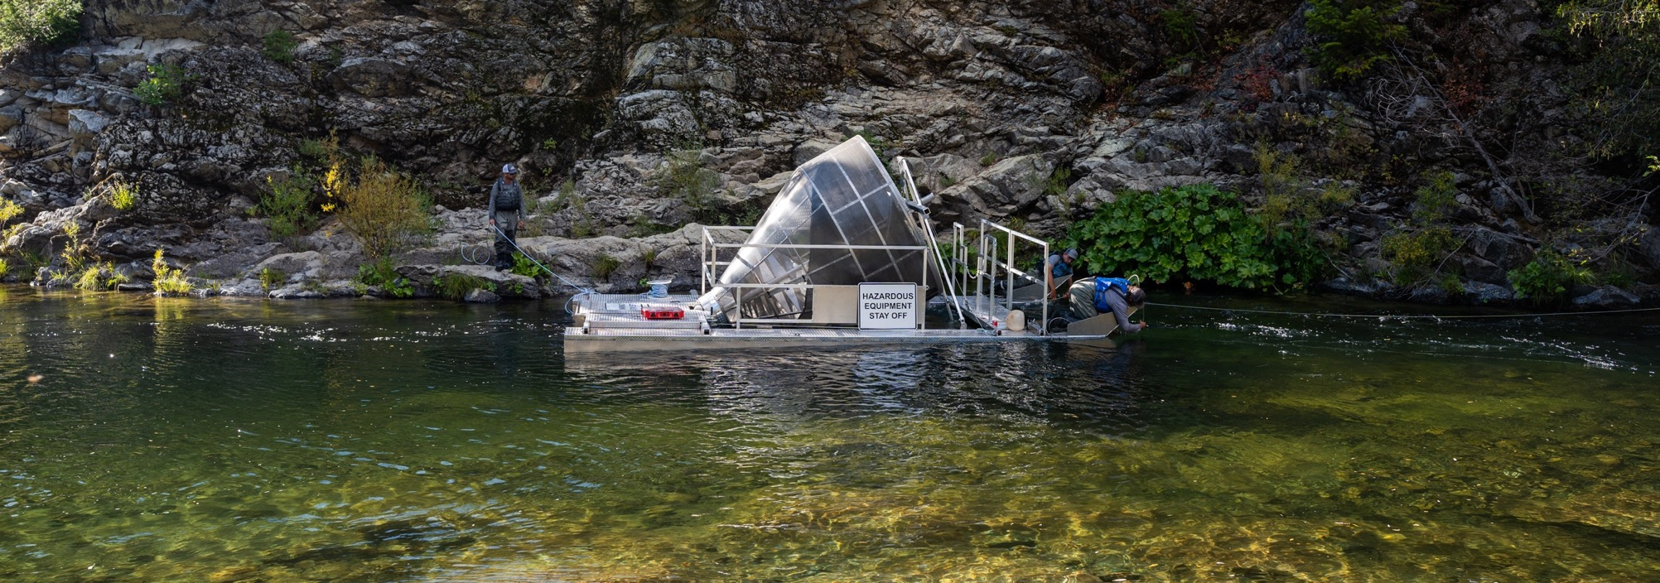
North Yuba Rotary Screw Trap Testing
Project Update
Presenter: Matt Peterson
Co-authors: Tommy Steele & Madisyn Pyorre
Downieville, CA | July 23, 2024

Slide 5
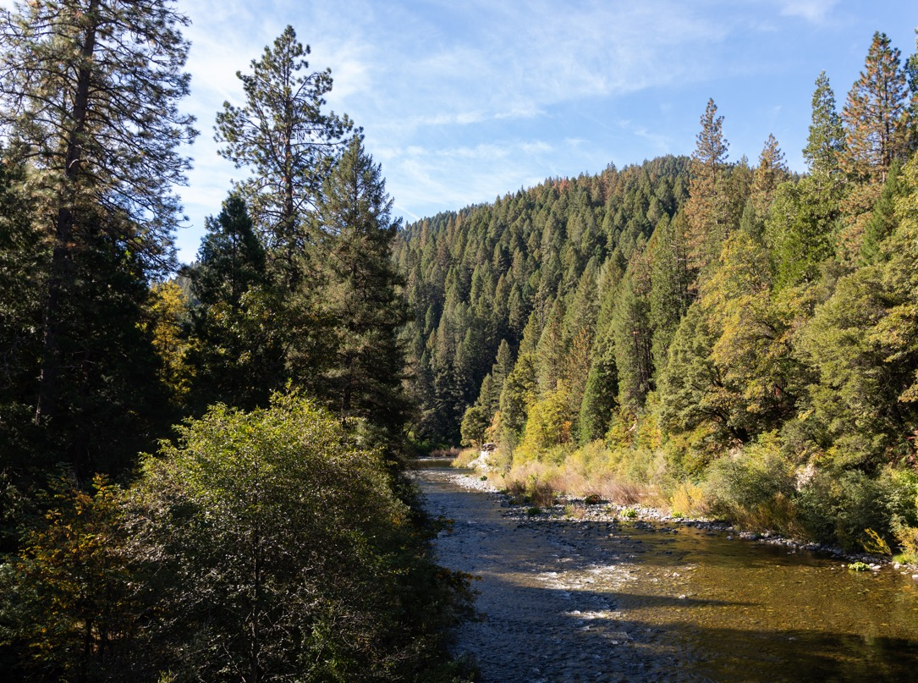
Overview
Background & Project Objectives
  Grant Tasks 5 & 6
Hydrology in WY24
What have we learned?
Next Steps
Questions & Discussion

Slide 6
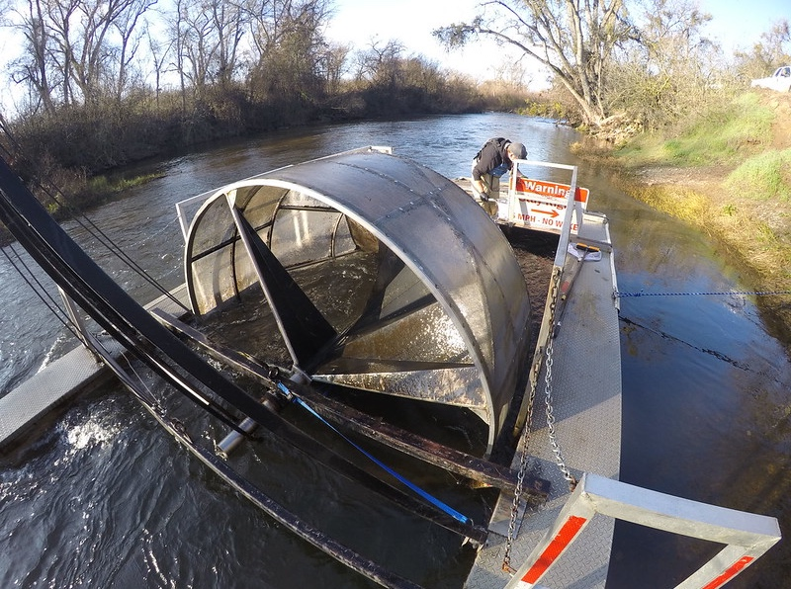
Purpose of a Rotary Screw Trap or RST?
Specially designed sampling device to capture juvenile salmon and steelhead in rivers
5’ or 8’ diameter cones
Main components are the cone, pontoons, A-frame, and live box
Cone can be raised or lowered via hand winches

Slide 7
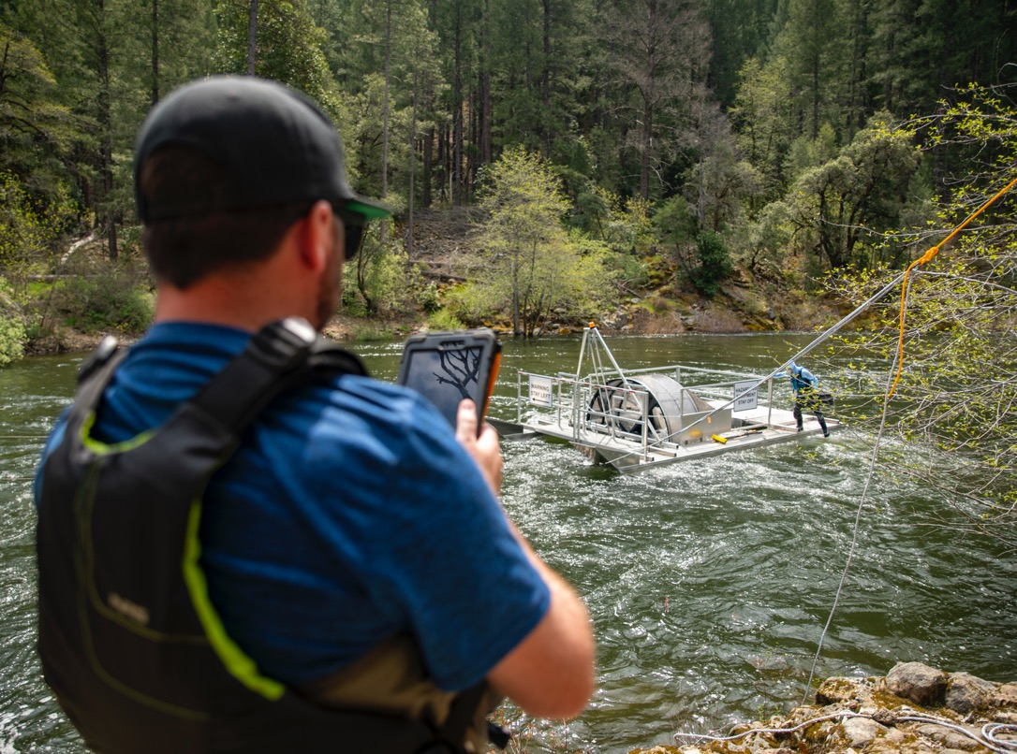
Overarching Goal
Assess feasibility and efficacy of RSTs as a fish collection method in the North Yuba River

Slide 8
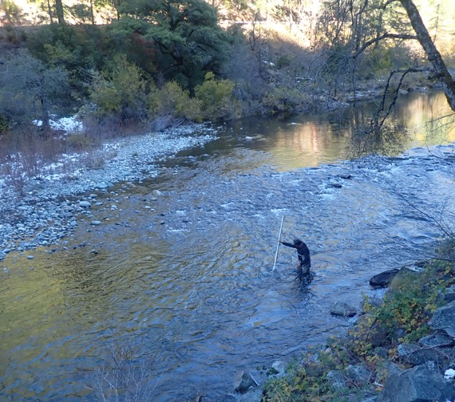
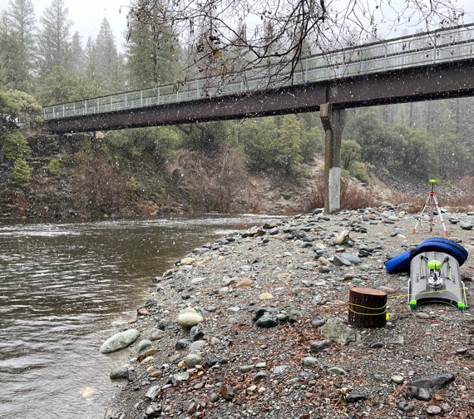
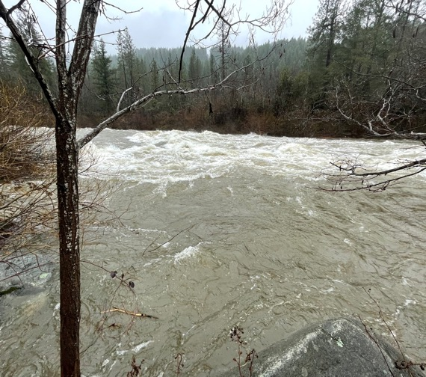
Site Selection Process for WCB Grant Task 5
Assessed 15+ potential sites on NYR
Scored sites on safety, operations, and logistics
Collected qualitative and quantitative data at select sites
Used data to conduct Initial scoring
Observed NYR at flows up to 7,000 cfs in WY23
Second round of scoring
Recommendations to YWA & YRWG on site selection

Slide 9
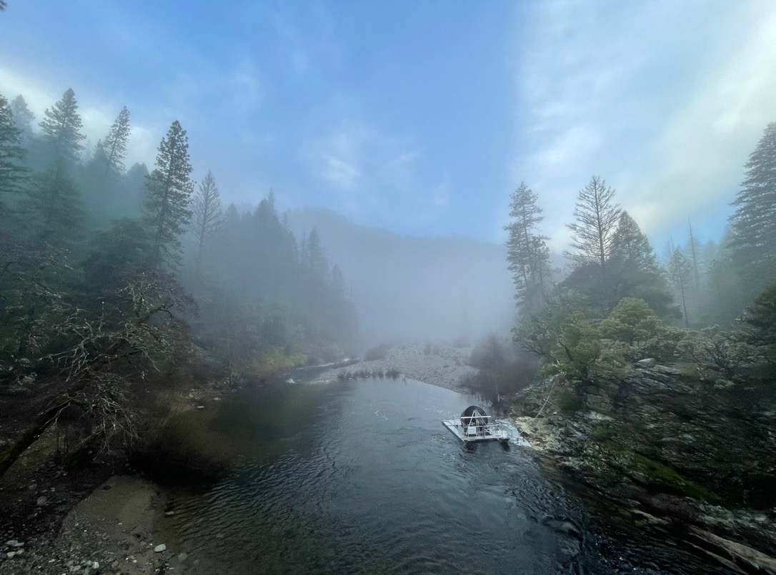
Specific Objectives of WCB Grant Task 6
Perform RST trials at range of flows
  October 2023 – May 2024
Determine limits of safe and effective operation
Characterize past hydrology
Based on data collected, estimate percentage of annual cohort that may be captured

Slide 10
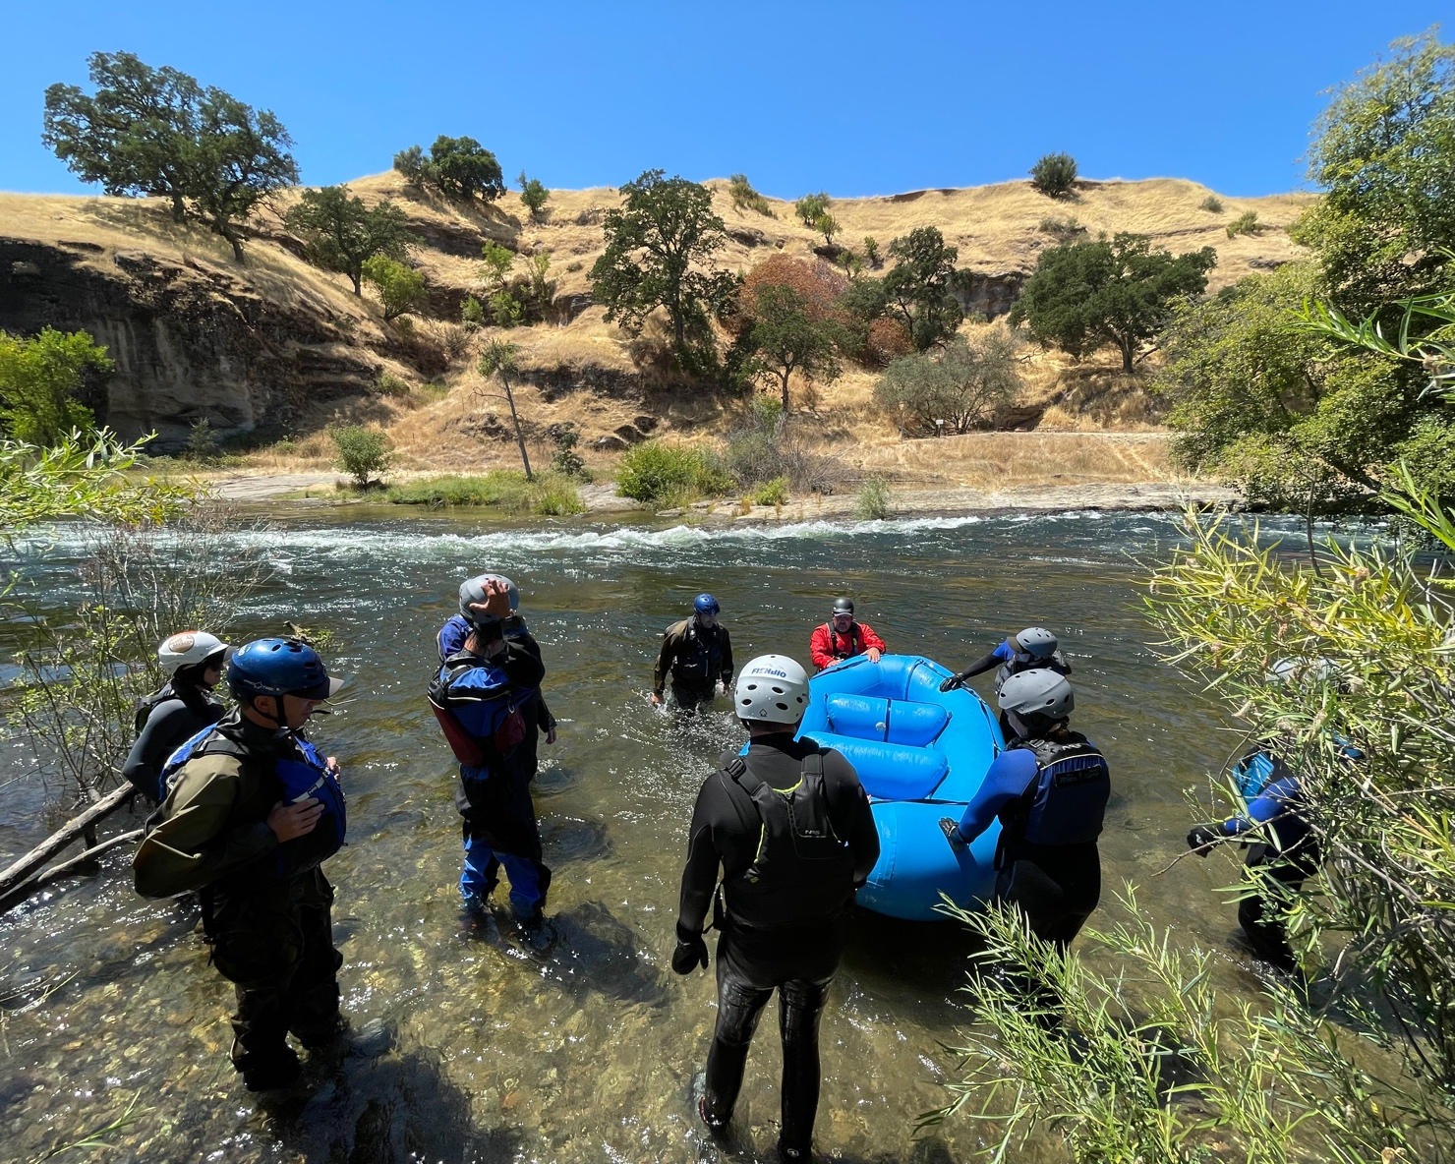
Safety
Internal commitment at FISHBIO
  Swiftwater Rescue Training
  Wilderness First Aid
Safety prioritized during both Tasks 5 & 6
Permitting processes
Field safety plans

Slide 11
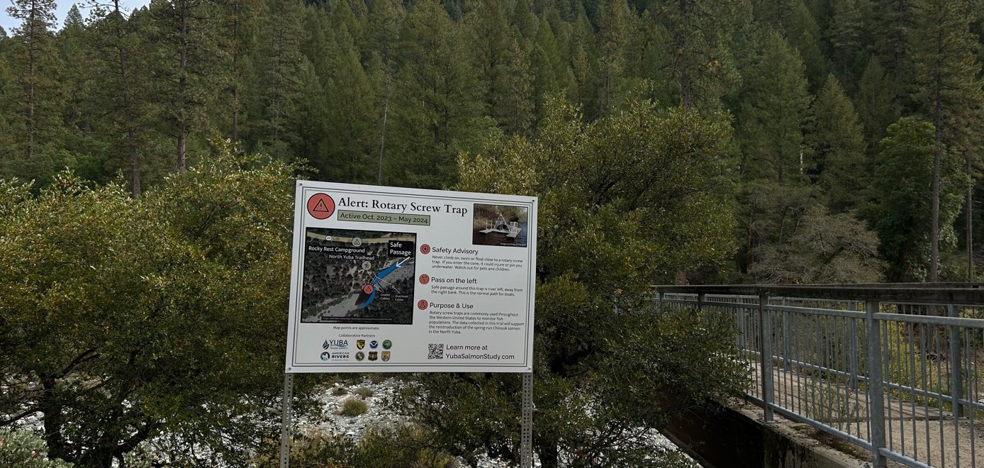
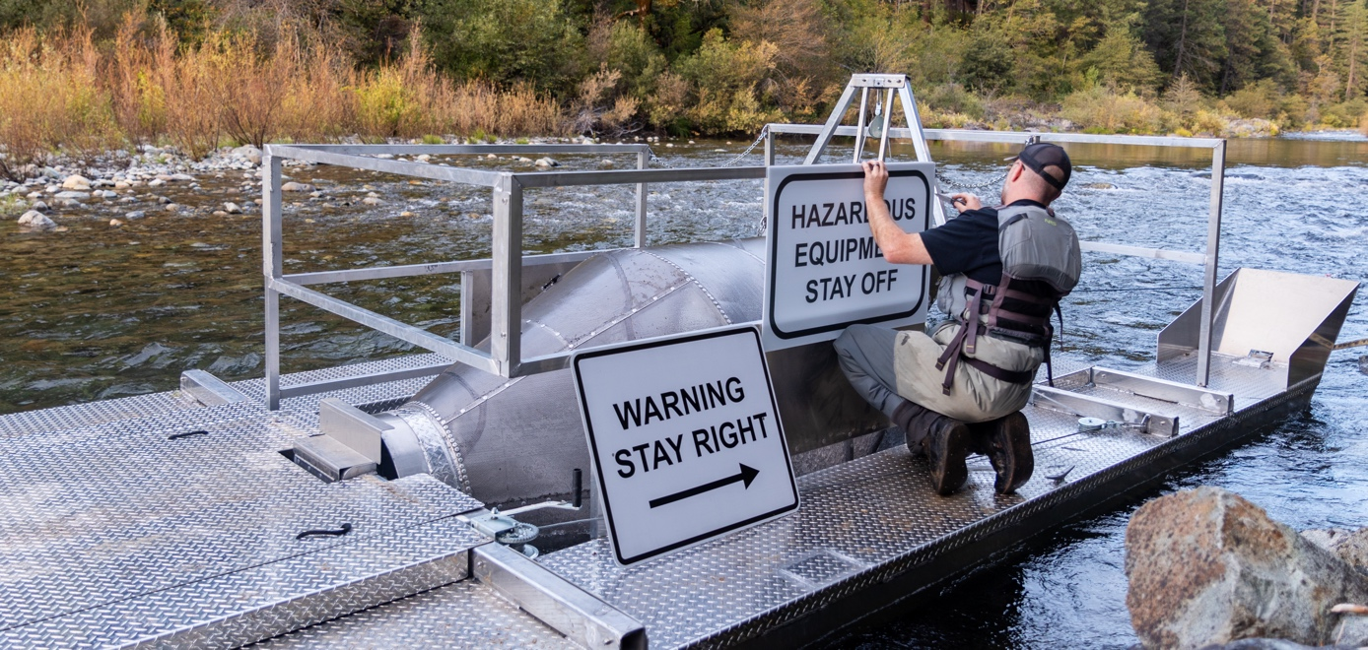
Outreach and Signage
Interpretive signage and website describing RST risks and safety (SYRCL)
Warning signage placed upstream of both RSTs and on RSTs to warn recreational users of hazards

Slide 12
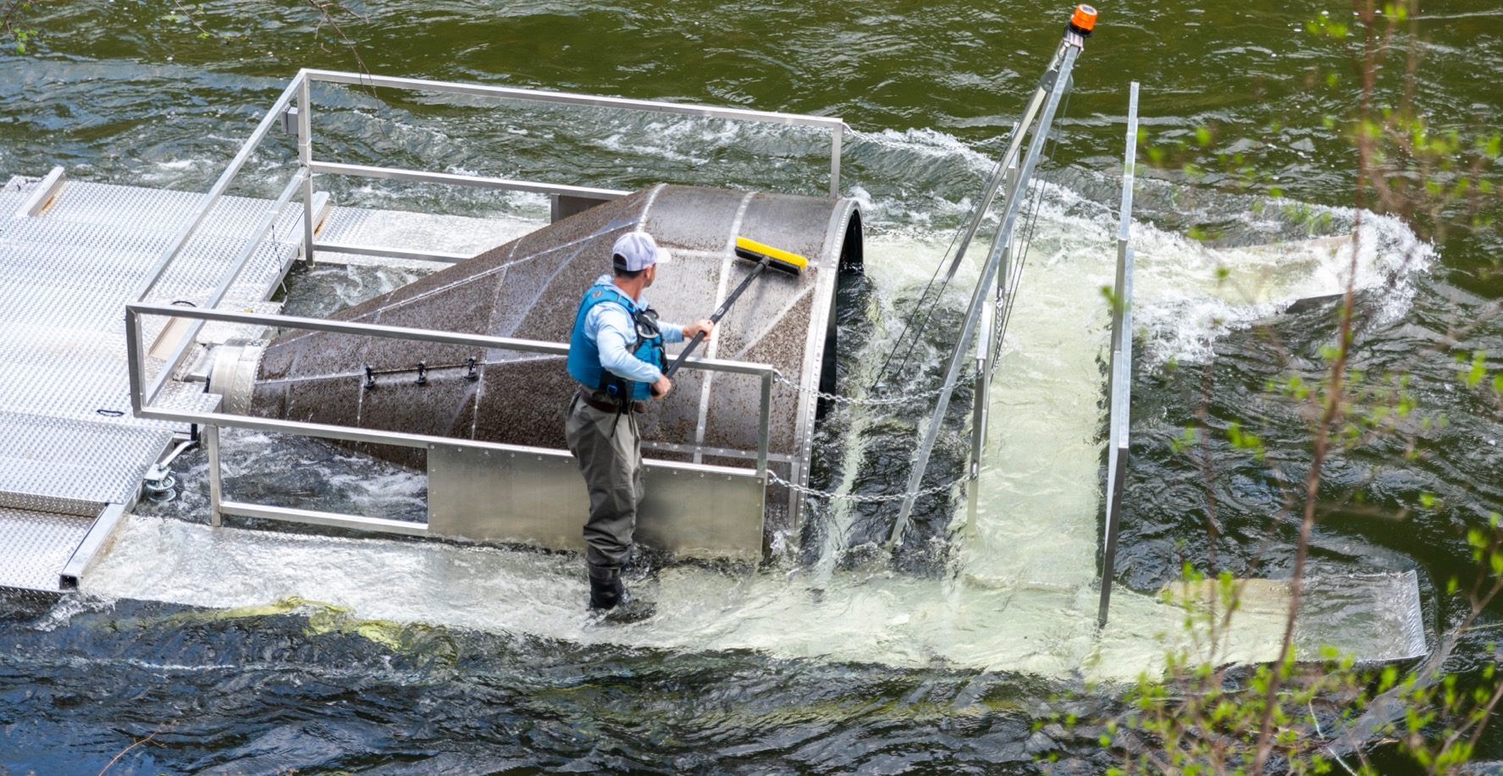
April 23, 2024
@ 2,470 cfs
Notes:
20.5 hours – 8’ RST clogged w/ moss and algae during diurnal fluctuations

Slide 13
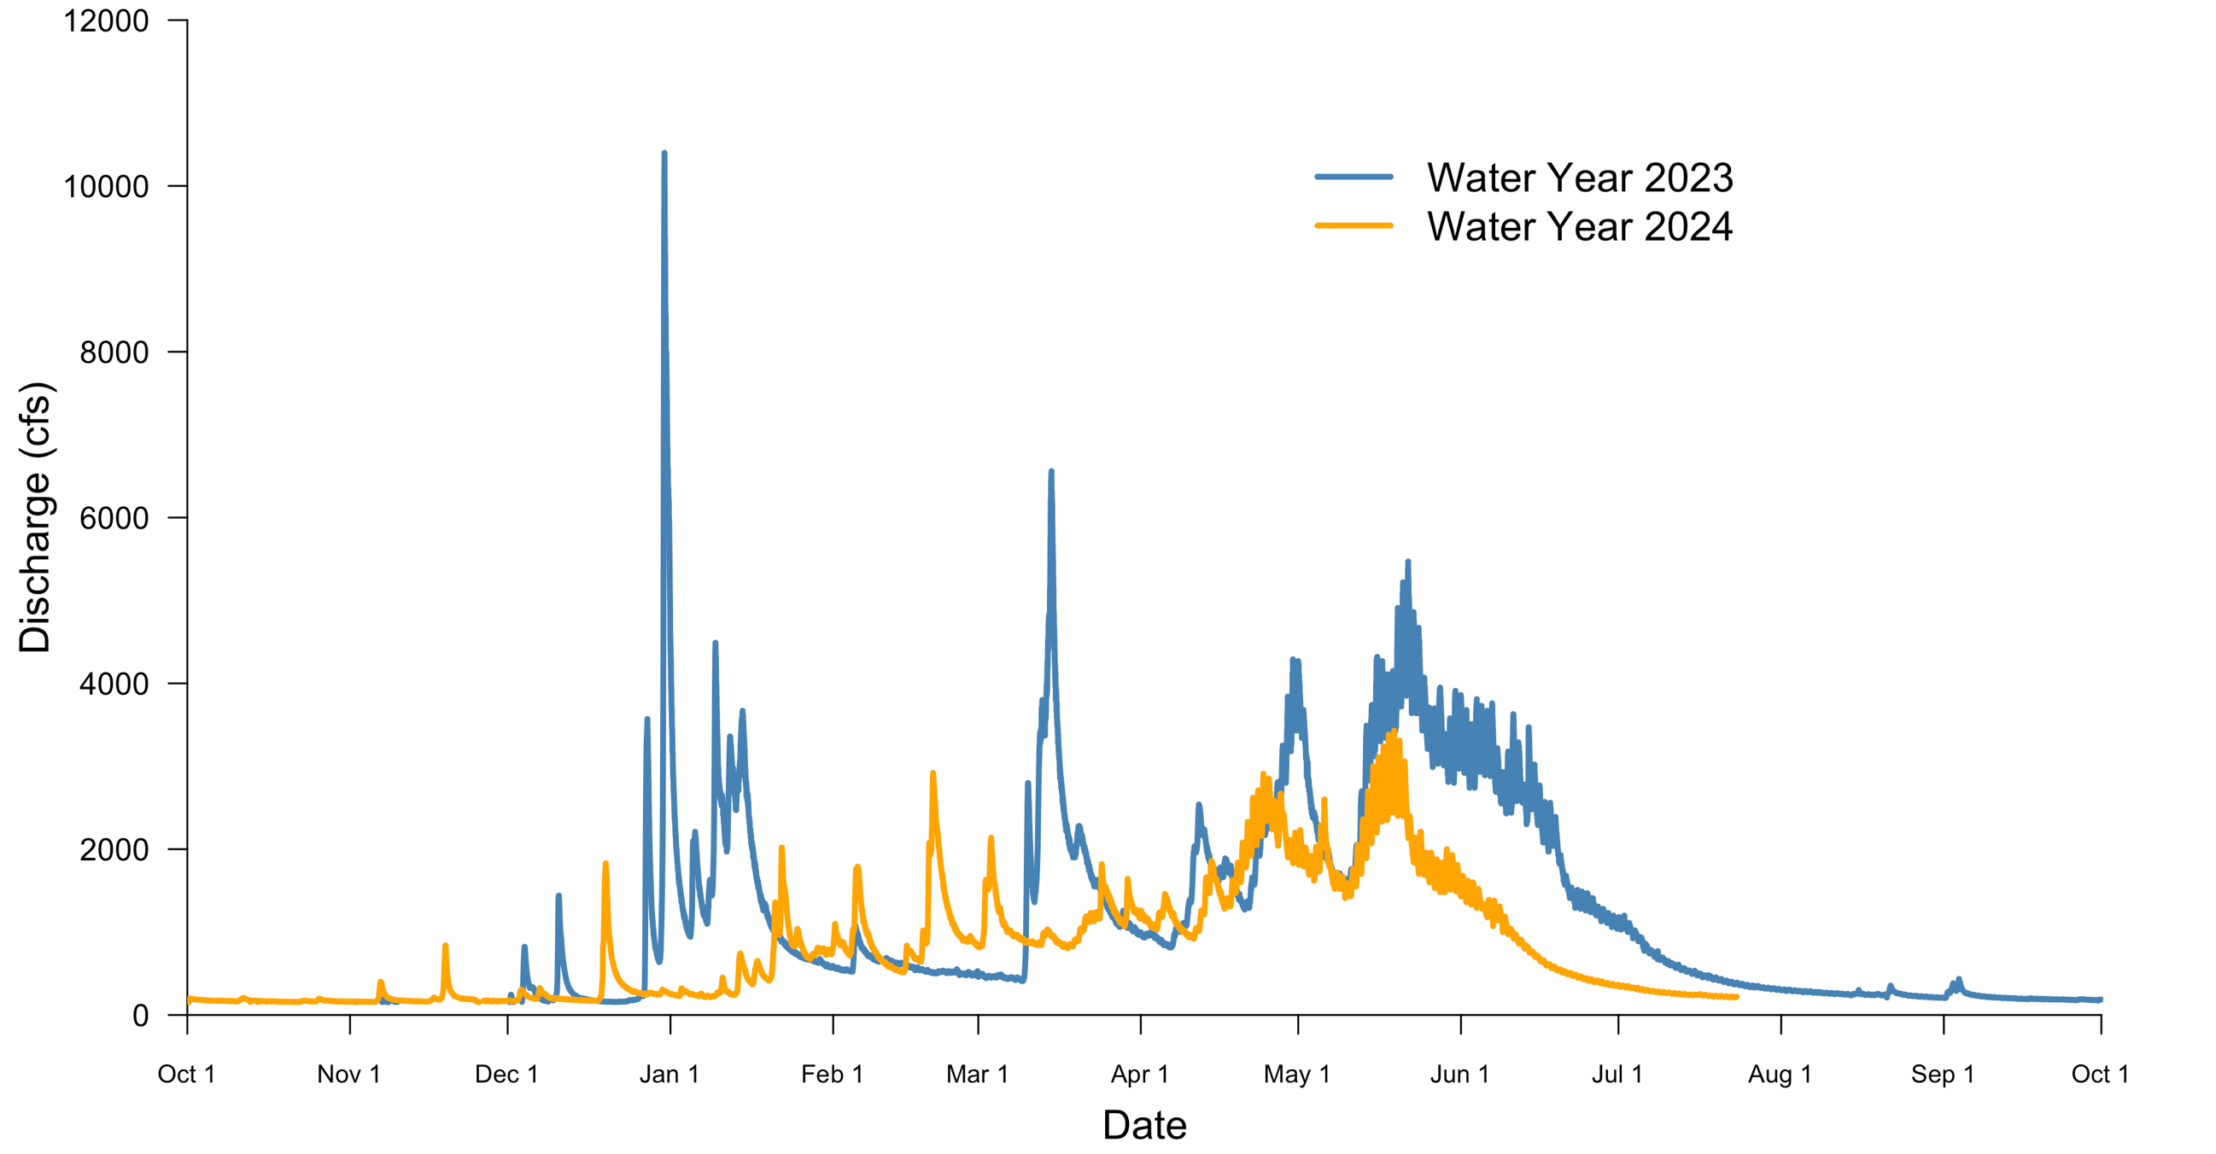
North Yuba Discharge (2023 vs. 2024)

Slide 14
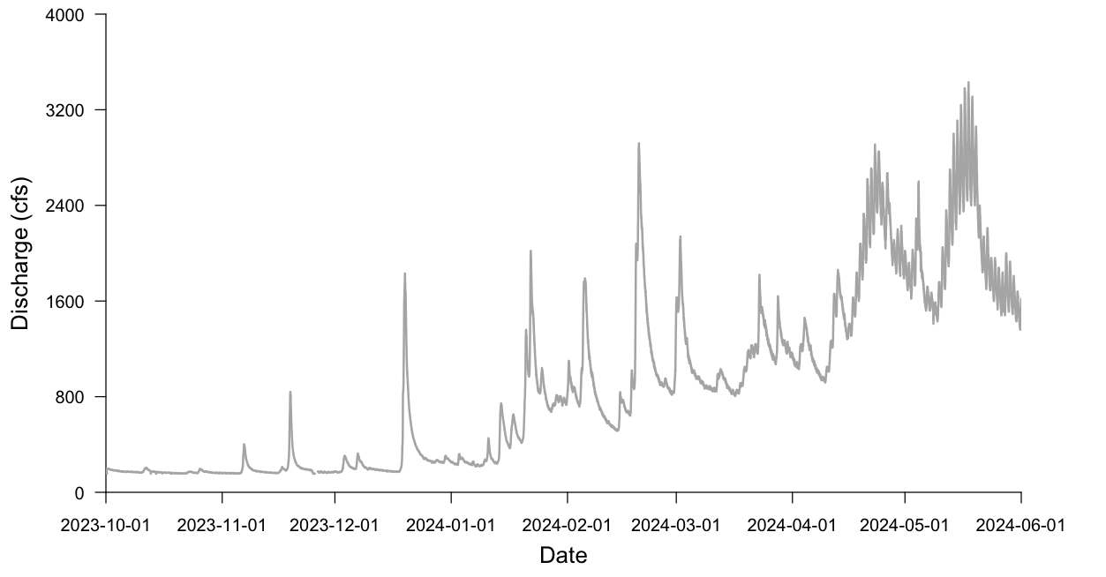
North Yuba Discharge (2024)

Slide 15
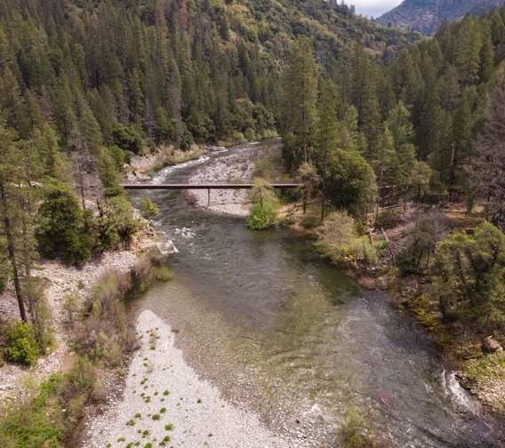
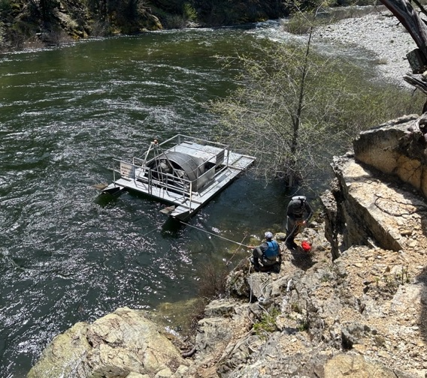
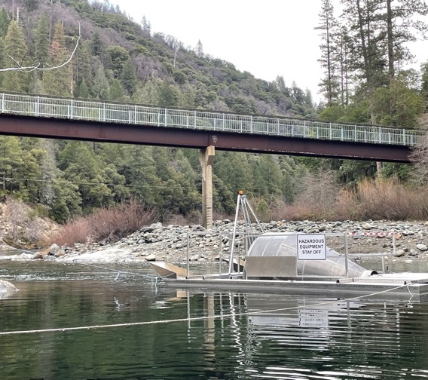
Rocky Rest Campground Site
Location: RM 25.6
One 8-ft diameter RST used
Positive Attributes:
Very accessible
Relatively safe access
Adequate flow characteristics
Negative Attributes:
Difficult install
High recreational usage & major raft take-out
Deep

Slide 16
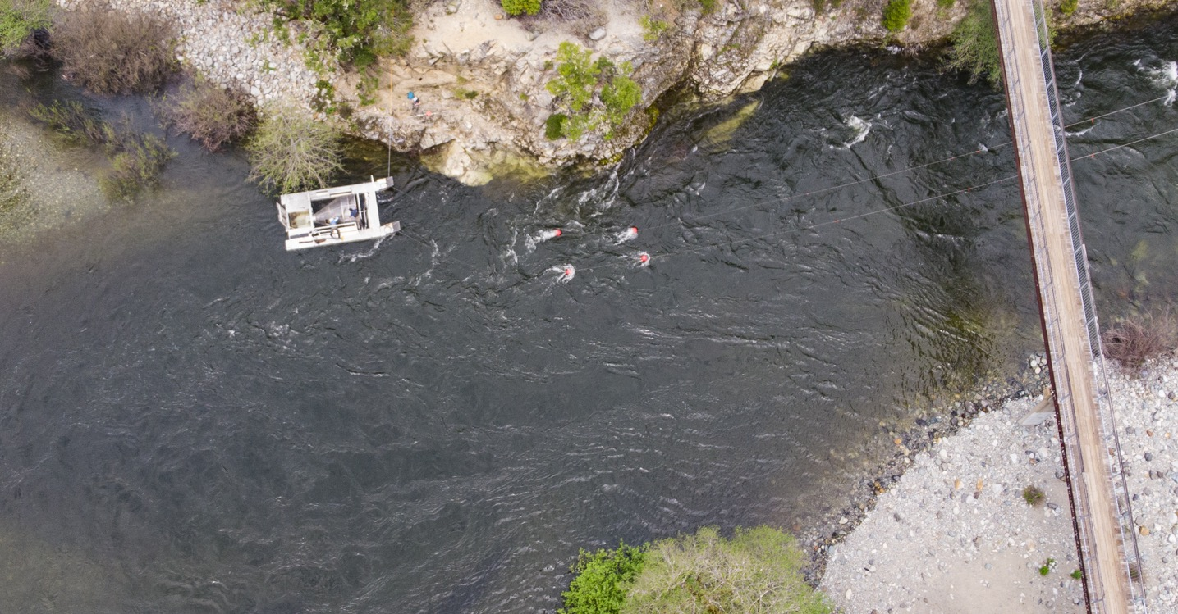
Rocky Rest Campground Site
@ 2,420 cfs
Notes:
For Dee: please make this a layout option for updated template

Slide 17
Direction of flow @ high discharge levels
Rocky Rest Campground Site
@ 2,420 cfs
Notes:
For Dee: please make this a layout option for updated template

Slide 18
Direction of flow @ low discharge levels
Rocky Rest Campground Site
@ 2,420 cfs
Notes:
For Dee: please make this a layout option for updated template

Slide 19
Upper Location
Stow Location
Middle Location
Lower Location
Rocky Rest Campground Site
@ 2,420 cfs
Notes:
For Dee: please make this a layout option for updated template

Slide 20
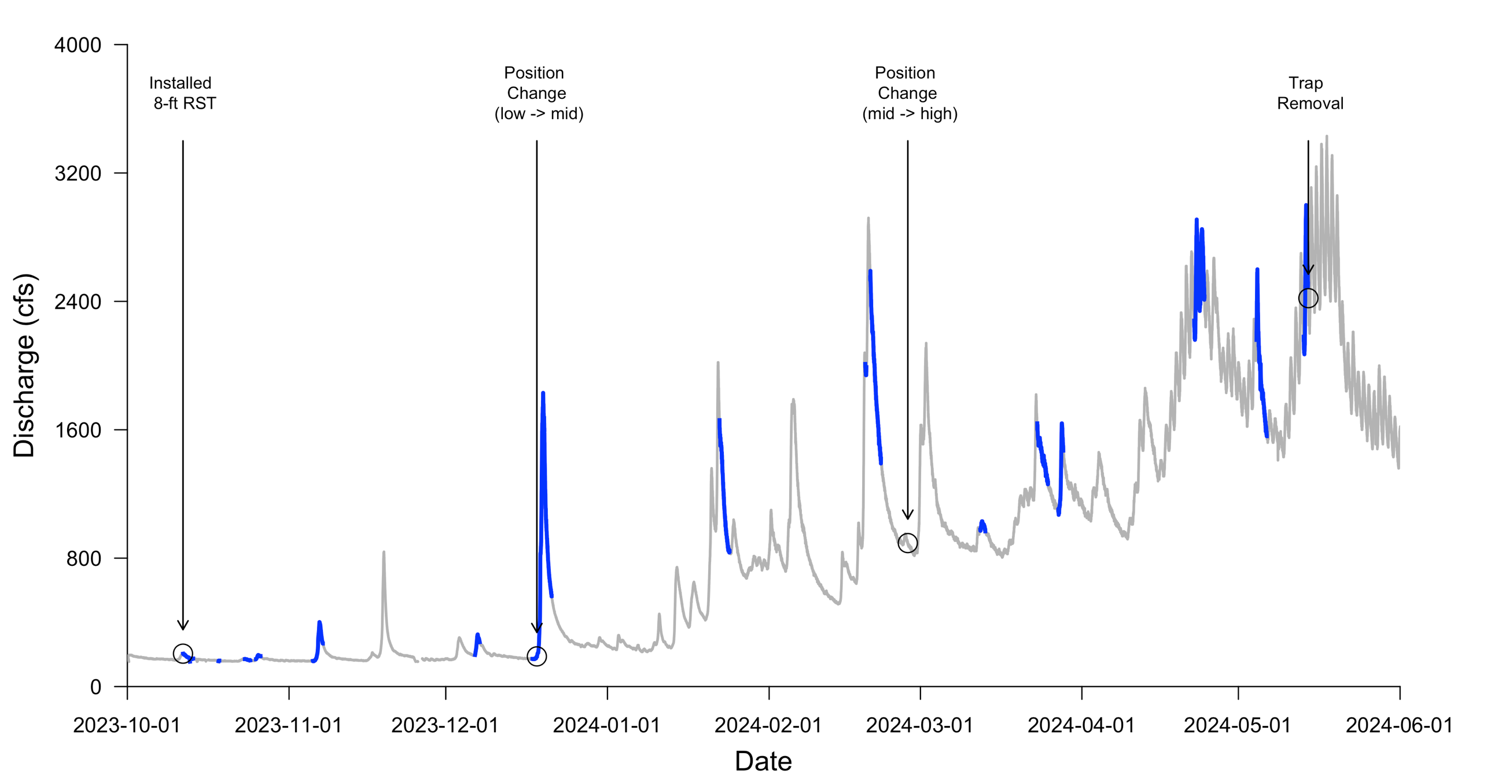
Rocky Rest Campground Site
Upper Limit = ~3,000 cfs

Slide 21
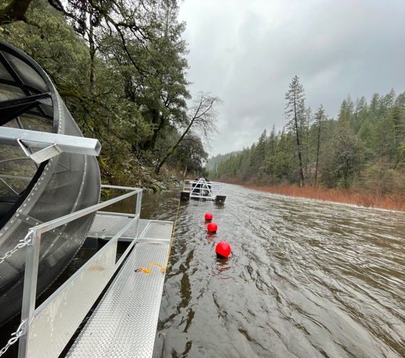
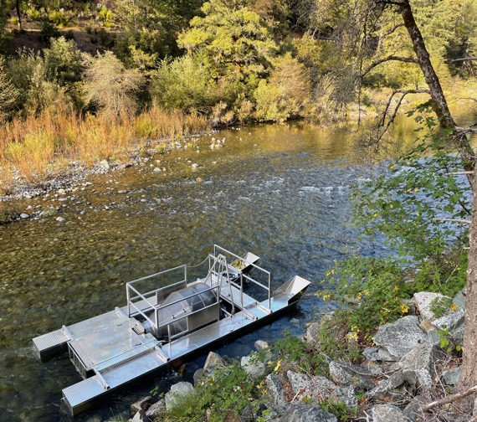
Old Toll Bridge Road Site
Location: RM 32.8
One 5-ft and 8-ft diameter RST used
Positive Attributes:
Safe access
Low recreational usage
Good flow characteristics
Negative Attributes:
Shallow
Two RSTs needed
Rip rap can easily damage RST cones
Notes:
Bullet spacing (vertical) doesn’t match same slide for Rocky Rest

Slide 22
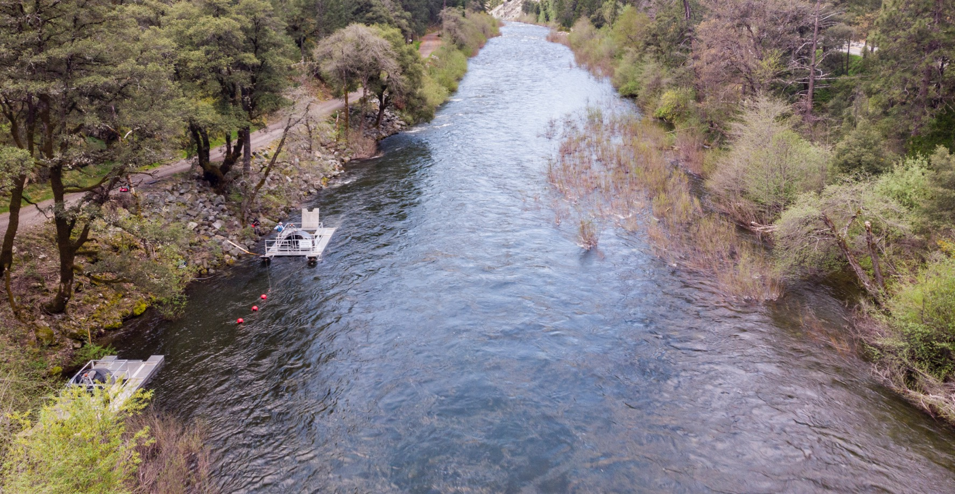
5-ft RST
8-ft RST
Stowage Location
Old Toll Bridge Road Site
@ 2,470 cfs
Notes:
2Setup/logistics
Single 8 ft RST for usage during
higher flows.
Single 5 ft RST for usage during
lower flows.
Install dates
Both traps Installed on 10/11/2023
Why this location
Access for deployment and retrieval
was manageable.
Minimal public activity resulting in less
chance of vandalism or theft.
Consistent river flow achieving greatest
trap performance.

Slide 23
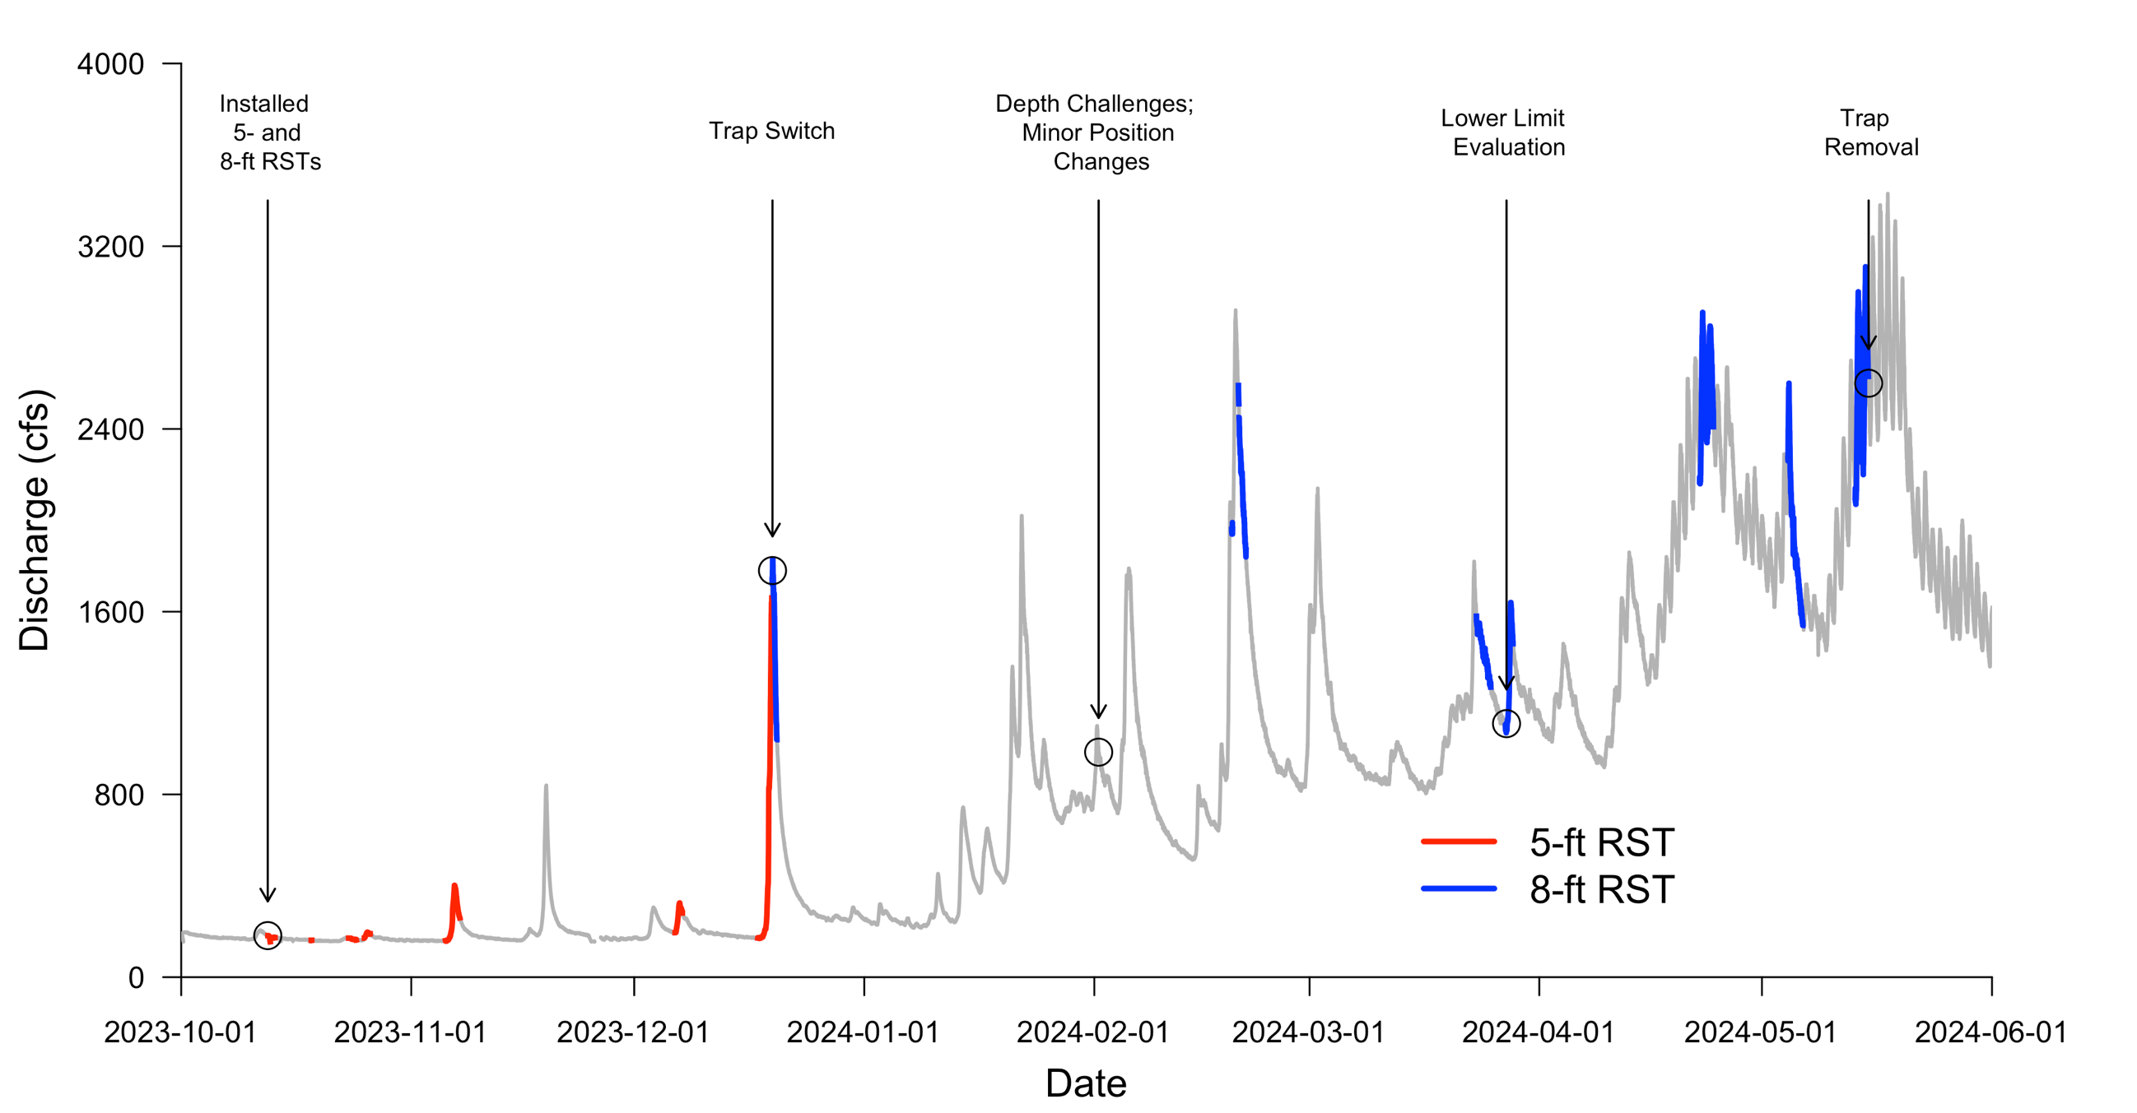
Old Toll Bridge Road Site
Upper Limit = ~6,000 cfs

Slide 24
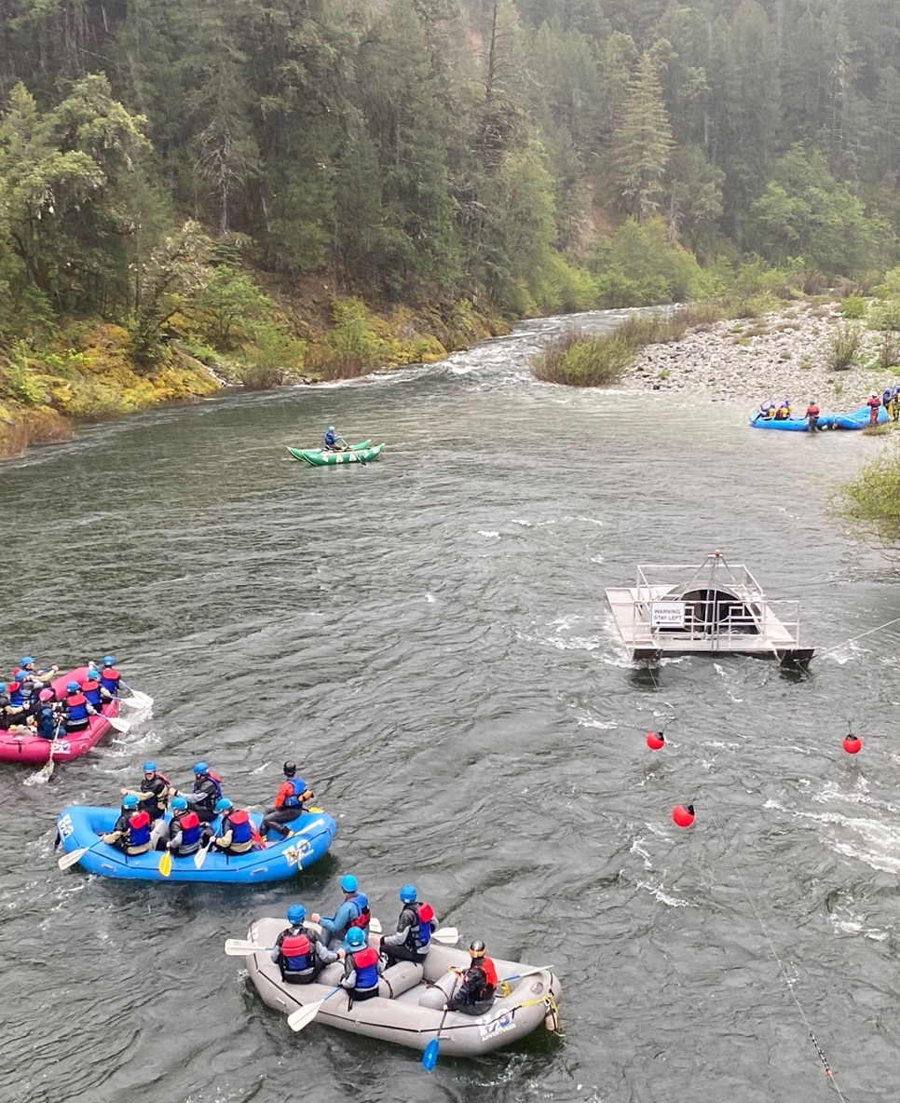
Public Interaction and Observations
Documented each interaction using tablet during field visits and with game cameras
Most common types were:
  Hikers
  Walkers
  Anglers
  Rafters during early May
Number of total observations correlated with season
  53 in Oct-Nov
  30 in Dec-Jan
  27 in Feb-May
@ 2,500 cfs
May 4, 2024

Slide 25
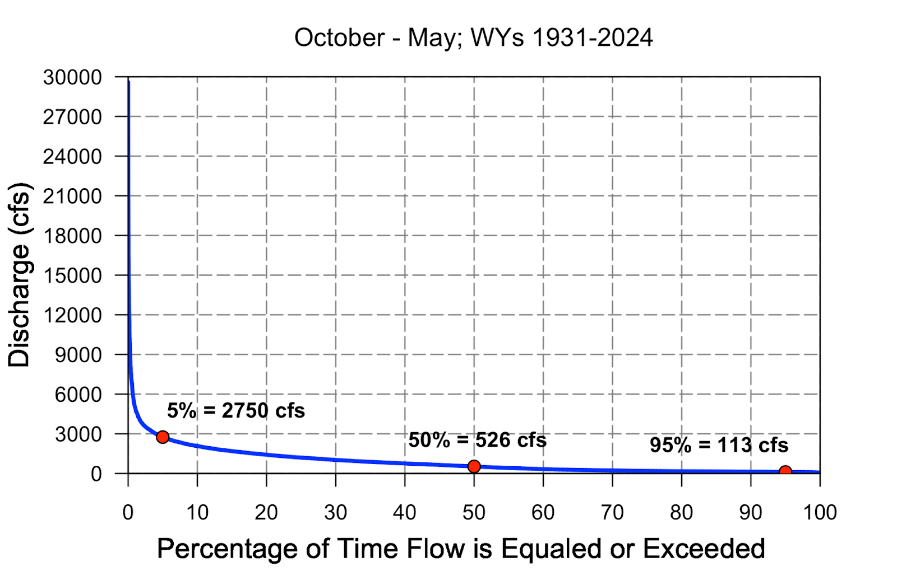
Hydrology: Flow Exceedance Curves
All daily discharges from 1931 – 2024

Slide 26
Hydrology: Flow Exceedance Curves
All daily discharges from 1931 – 2024
Rocky Rest upper limit is ~3,000 cfs
Daily discharges of 3,000 cfs were equaled or exceeded 4.04% of the time
100% – 4.04% = 95.96%

Slide 27
Hydrology: Flow Exceedance Curves
All daily discharges from 1931 – 2024
Old Toll upper limit is ~6,000 cfs
Daily discharges of 6,000 cfs were equaled or exceeded 0.67% of the time
100% – 0.67% = 99.33%

Slide 28
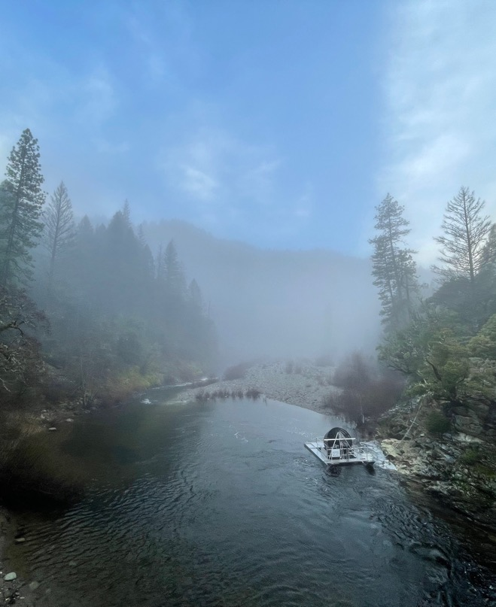
Next Steps for FISHBIO
RSTs were removed in mid-May 2024
July – August 2024: Community meetings in Downieville and/or Nevada City
May – August 2024: Draft technical memo
August 31: Submit draft to YWA
September 30: Address comments and finalize technical memo
Fall 2024: Assist CDFW as needed with their plans and continue transferring knowledge to their staff
Notes:
Title doesn’t line up w/ title from other slide.

Slide 29
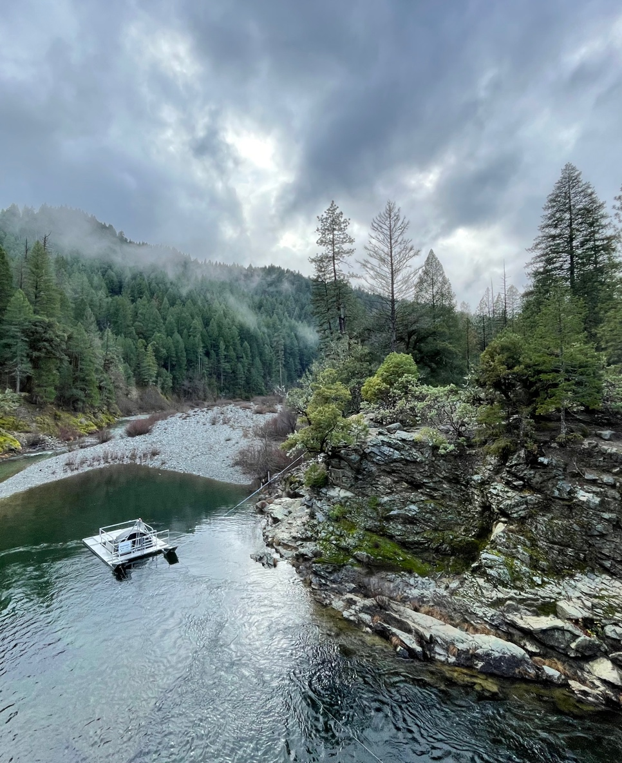
Main Takeaways
Two-year process to identify sites and test RSTs
  Unregulated discharge
  October – May is cold and wet
Prioritized safety throughout the process
  Important discussions had by all stakeholders
Outlook on usage of RSTs on the North Yuba River
  Sites chosen were amenable for RST operation of up to 3,000 and 6,000 cfs depending on the site
  Continued refinements of operations are needed as CDFW shifts to the next phase of the program

Slide 30
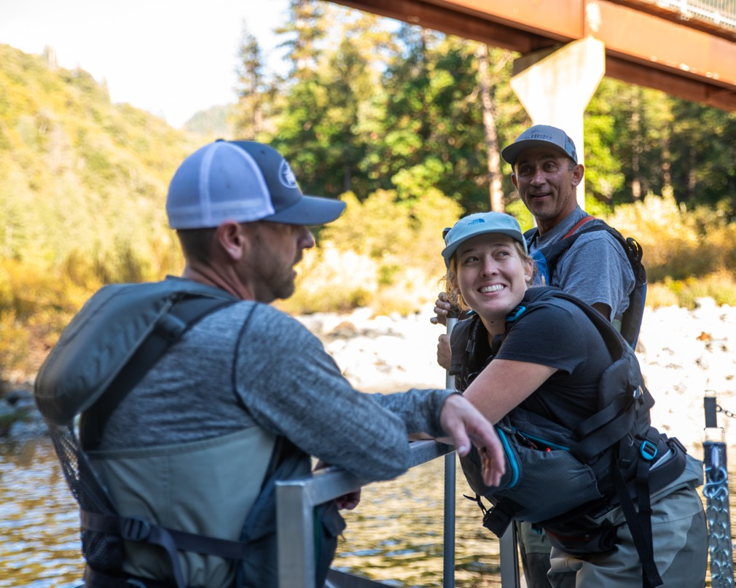
Acknowledgements
Funding provided by: Wildlife Conservation Board Drought Relief Grant funding administered by Yuba Water Agency
We thank the following people for their assistance:
Madisyn Pyorre, Tommy Steele, Jason Guignard, Patrick Cuthbert, Jeremy Pombo, Garth Jaehnig, Dana Lee, Michael Hellmair, Emily Jonagan, Dee Thao, Liam Radecke, and Tyler Pilger (and many others from YWA, USFS, CDFW, and NMFS)
Notes:
Matt, please update as you see fit - MSP

Slide 31
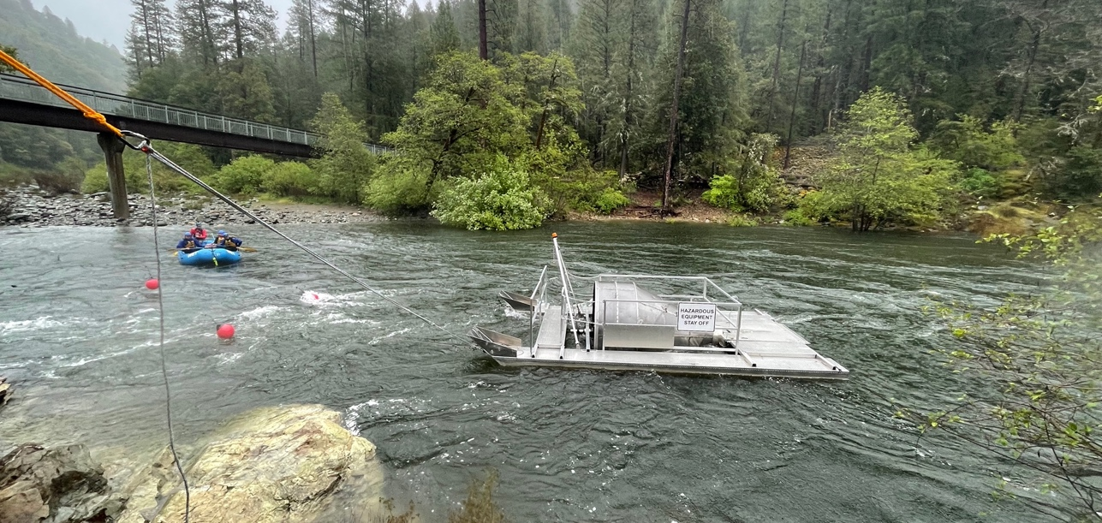
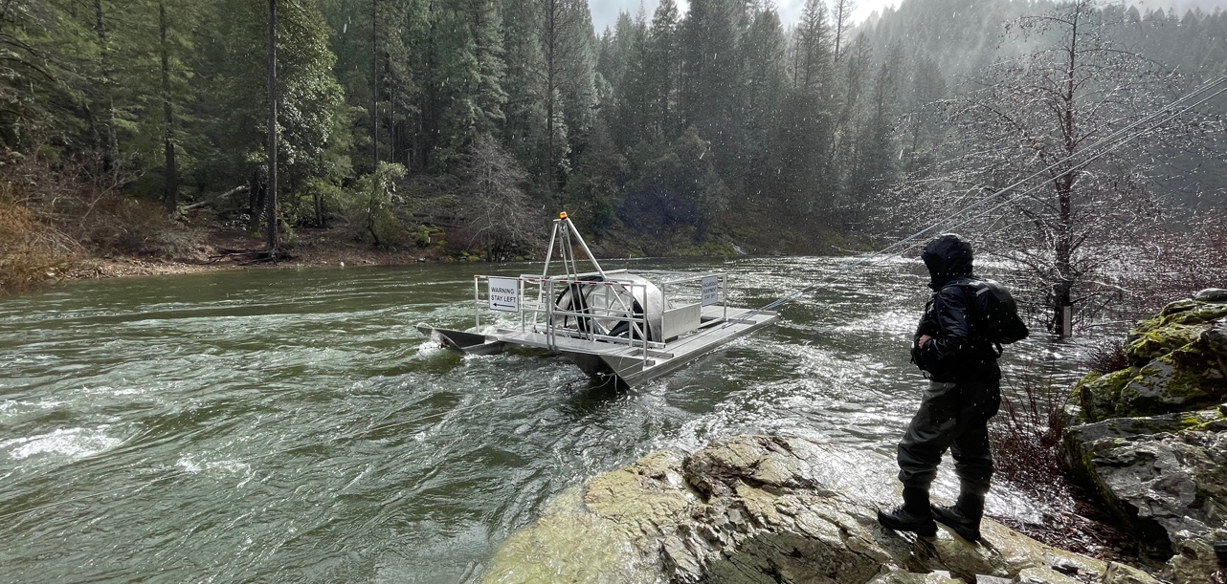

Questions?
Matt Peterson | Project Manager
mattpeterson@fishbio.com | (530) 892-9686

Slide 32
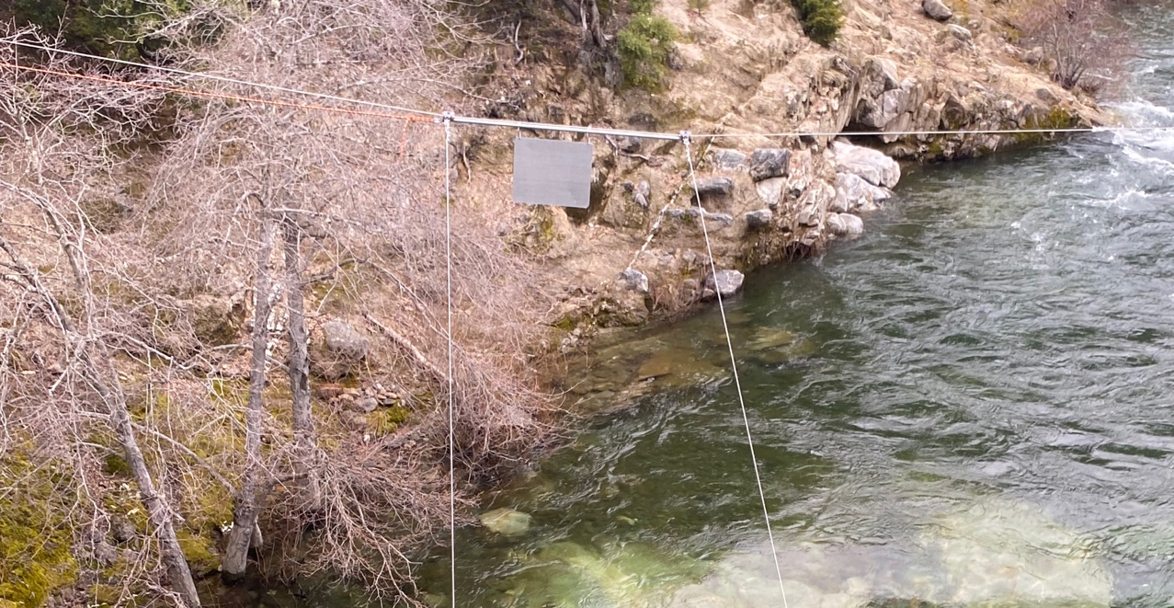
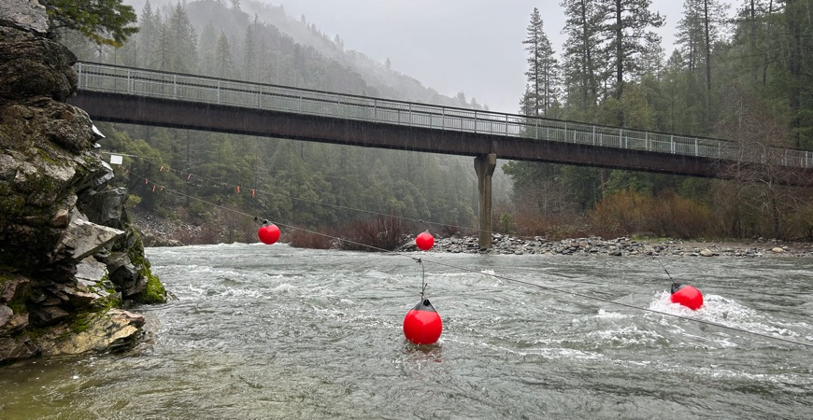
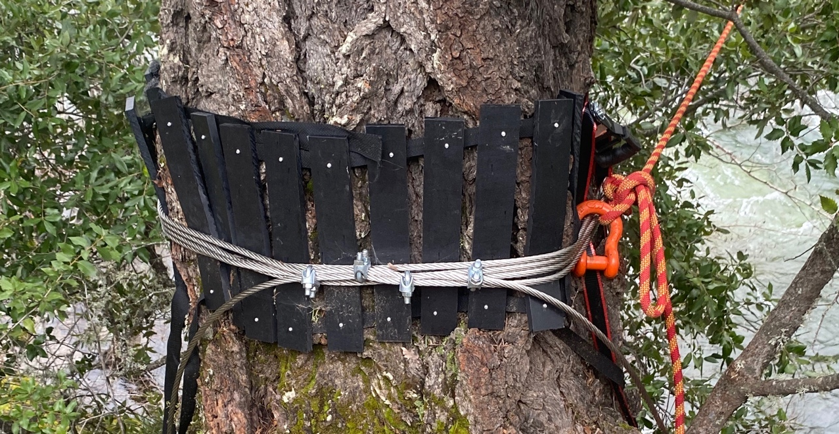
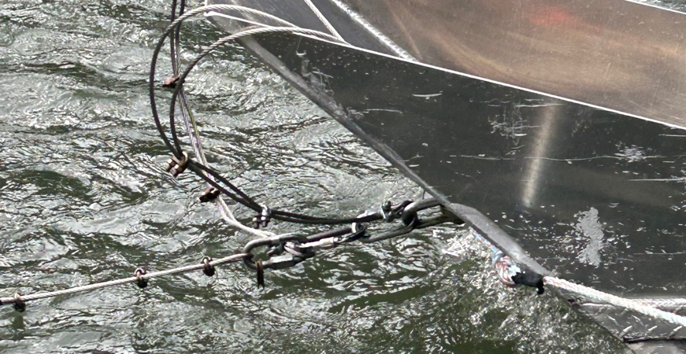
Safety Buoys
Overhead Cable & Gantry
Site Rigging (Rocky Rest)
Anchor Point
Leader Cable

Slide 33
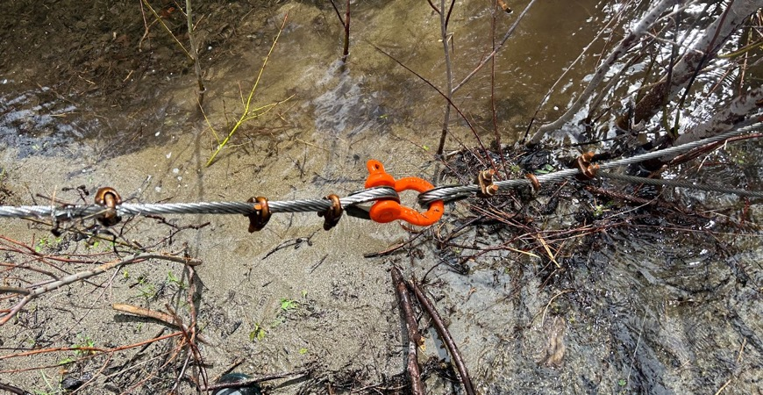
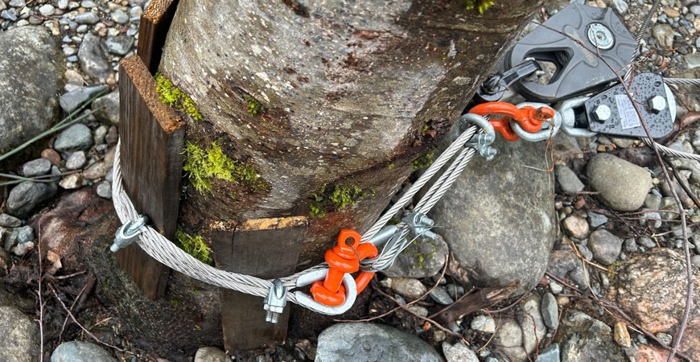
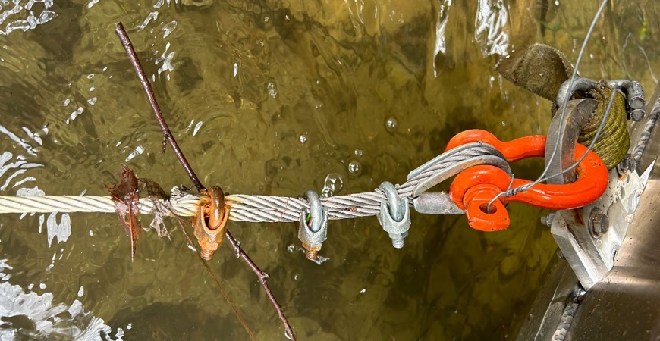
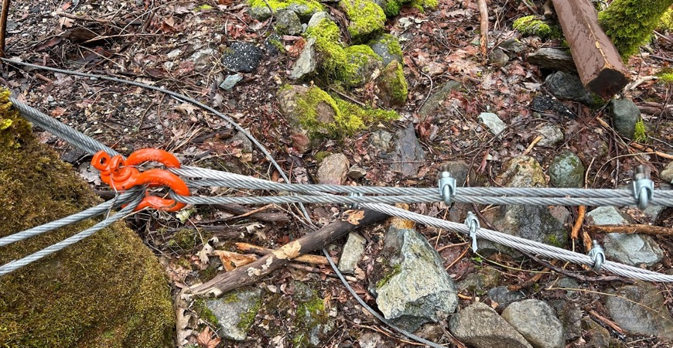
Bridle
Vector Point
Site Rigging (OTB)
End Loop Setup
Anchor

Slide 34
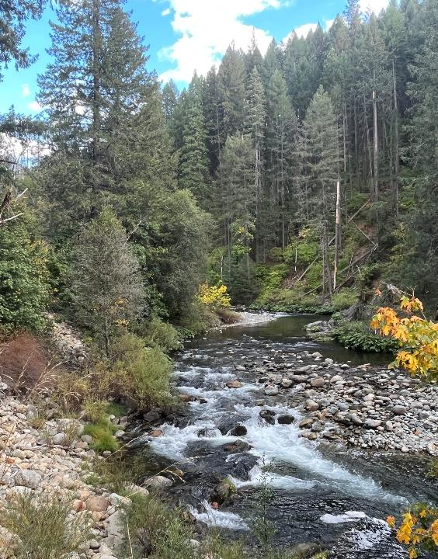

Pilot Studies to inform the North Yuba River Spring-Run Chinook Salmon Reintroduction Program
Presented by:
Michelle Forsha
Senior Environmental Scientist Supervisor
Fisheries Restoration and Reintroduction Unit
North Central Region
California Department of Fish and Wildlife
Notes:
Welcome and introduction

Slide 35
Agenda
Program Background
Pilot Study Development Process
Near-Term Pilot Study Overview and Timeline
Potential Impacts to the Public
How the Public Can Engage
Next Steps
Notes:
Agenda
Logistics for Questions

Slide 36
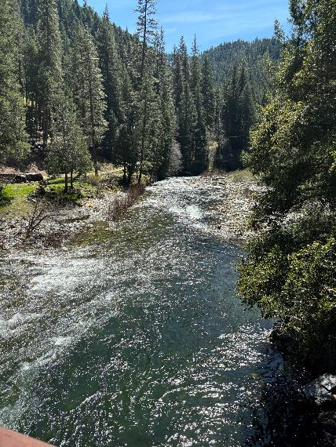
North Yuba River Reintroduction Program
Program Goal
  The goal of the North Yuba River (NYR) Spring-run Chinook Salmon Reintroduction Program (Program) is to contribute to the establishment of a viable and independent population of spring-run Chinook salmon (SRCS) within the North Yuba River upstream of New Bullards Bar Reservoir.
Notes:
The goal of the North Yuba River (NYR) Spring-run Chinook Salmon Reintroduction Program (Program) is to contribute to the establishment of a viable and independent population of spring-run Chinook salmon (SRCS) within the North Yuba River upstream of New Bullards Bar Reservoir.
How exciting is this goal? Being able to continue towards returning a species to where they have been excluded for xx years has brough me to much fulfillment in this potions. It feel really good to be contributing towards achieving the goals of this Program and having a positive impact on the species.

Slide 37
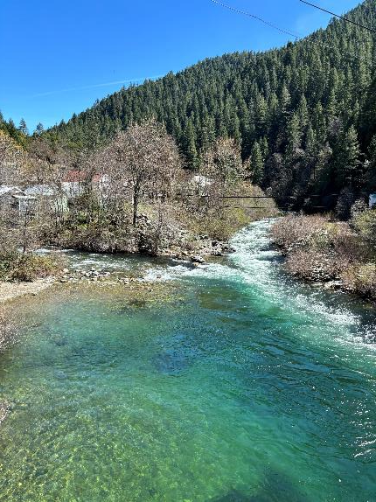
North Yuba River Reintroduction Program
Program SRCS Benefits
  Contributing to recovery of Threatened species listed by ESA and CESA
  Increase the overall amount of habitat available
  Decrease the possibility of impacts from catastrophic events
  Decrease population effect cause by increasing water temperatures
  Increase genetic diversity
Notes:
By expanding the geographic range for SRCS this Program would provide many benefits to the species including increasing the overall amount of habitat available, deceasing the possibility of impacts from catastrophic events, decreasing population effect caused by increasing water temperatures and increasing genetic diversity.
Work to provide example and/or going into detail on benefits of having multiple independent populations of SRCS

Slide 38
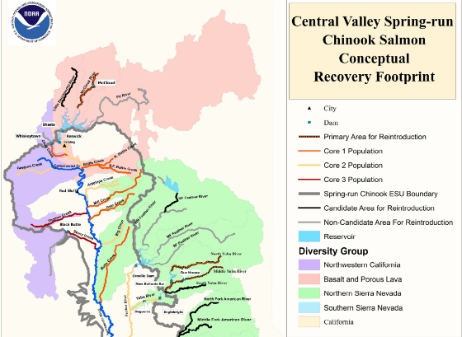
North Yuba River Reintroduction Program
Relevant Spring-run Chinook Salmon Recovery Actions:
NMFS 2014 Recovery Plan for SRCS
  Recovery Action 3.3.2 – Reintroduction of SRCS to historic habitat now inaccessible due to rim dams
Governor’s 2024 California Salmon Strategy for a Hotter, Drier Future
  1.3 By the end of 2024, …initiate a salmon reintroduction program on the Yuba River (CDFW)

Slide 39
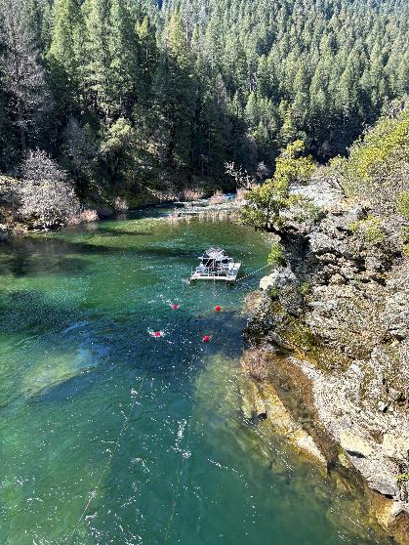
North Yuba River Reintroduction Program
Yuba Reintroduction Working Group – Key Members
  California Department of Fish and Wildlife
  National Marine Fisheries Service
  Yuba Water Agency
  United State Fish and Wildlife Service
  United States Forest Service
  Pakan’Yani Maidu of Strawberry Valley Rancheria
  South Yuba River Citizens’ League
  California Sportfishing Protection Alliance
  American Rivers
  And more

Slide 40
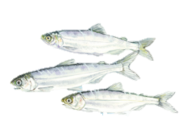
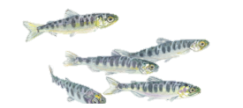

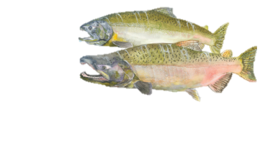

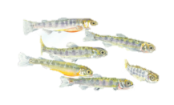
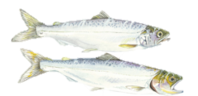
North Yuba River Reintroduction Program
Collect and Transport
New Bullards Bar Reservoir
Englebright Dam
Collect and Transport
Upstream
Downstream

Slide 41

North Yuba River Reintroduction Program

Slide 42

North Yuba River Reintroduction Program

Slide 43

Why the North Yuba River?
Most temperature-suitable habitat
Most upstream fish passage barrier
Convenient access via Highway 49
Opens approx. 33 river miles of habitat, providing access to additional holding, rearing, and spawning habitat

Slide 44

Questions?

Slide 45

Near-Term Pilot Study Development Process
Conducted pre-pilot RST testing
Conducted public & tribal outreach
Gained YRWG consensus to priorities use of SRCS in near-term pilot studies, as available
Initiated permitting
Initiated NMFS pathogen study
Drafted, reviewed, and finalized near-term pilot study plans

Slide 46

Near-Term Pilot Study Overview
Instream Egg Incubation Study
Juvenile Collection and Transport Study
Habitat Characterization and Utilization Study
Parentage-based Tagging Study
Starting with SRCS eggs and juveniles only collected from the Feather River Fish Hatchery. No adults will be moved at this time.
Timeline TBD and dependent on funding. Ideally to start Nov 2024 and be implemented over two consecutive years. Funding to be resolved prior to eggs/fish being placed in water.
Notes:
These studies would be used to inform future efforts including program implementation.
egg incubation
Hydraulic injection, egg boxes, streamside incubators
migration routing
Pit tags, acoustic tagging
juvenile mark/recapture
RST, incline plane traps, juvenile collection systems, beach seine, minnow traps
trap and haul of juveniles and adults
Juvenile/Adult collection
Genetics
PBT, eDNA
habitat utilization
Snorkel surveys, beach seine
redd surveys and monitoring
Carcass surveys and monitoring
Pre-spawning mortality
predation

Slide 47



Instream Egg Incubation Study
Overview:
  Test two instream egg incubation methods
    Hatch Partner Instream Egg Incubation Box
    Hydraulic Egg Injection
Objectives:
  Determine differences in egg-to-fry survival between different egg incubation methods and locations
  Inform future Program egg incubation methodology

Slide 48

Instream Egg Incubation Study
Egg Placement:
  Starting with 250k eyed SRCS eggs, 125K using each method
  Eggs placed in 5 TBD locations within the NYR. Each group containing 5 Hatch Partners and 5 Hydraulic Injection sites, with 5k egg per box/injection site for a total of 50K eggs per location
    Site selection TBD based on presence of spawning gravel, water temperature, and other factors

Slide 49
Instream Egg Incubation Study
Draft Timeline
  Implementation pending program funding
  To be repeated in 2025-2026
Jul – Oct 2024
Study Planning and Permitting
Early Nov 2024
Eggs Placed for Incubation with NYR
Jan – Mar 2025
Fry Emerge from Incubation
Start of Egg Monitoring
End of Egg Monitoring
Mar - Jul 2025
Analyze and Report Findings

Slide 50


Juvenile Collection and Transport Study
Overview:
  Operate two rotary screw traps (RSTs) at Rocky Rest Campground to collect juvenile SRCS incubated in the NYR
Objective:
  Evaluate emigration timing, growth, and health of juvenile SRCS in response to environmental conditions
  Continue to evaluate effectiveness of RST within the conditions of the NYR
  Transport collected SRCS below Englebright Dam
Notes:
Highlight: will provide information on emigration timing, over summering behavior exhibited by SRCS

Slide 51

Juvenile Collection and Transport Study
RST Location – Rocky Rest Campground
  Two RSTs operating side-by-side
  Both RSTs to be installed January 1
  First RST to be removed approx. May 1 (prior to start of rafting season)
  Second RST to be removed approx. May 31 (prior to peak of rafting season)
  RSTs re-installed approx. Oct 1 – May 31 the following year
  Not sampling approx. May 31 – Oct 1
  Capture efficiency

Slide 52
Juvenile Collection and Transport Study
Jul – Dec 2024
Study Planning and Permitting
Jan 1, 2025
Two RSTs Installed at Rocky Rest Campground
May 2025
One RST Removed by May 1
Second RST Removed by May 31
Start of Daily RST Monitoring and Juvenile Transport
End of RST Monitoring
May - Sept 2025
Analyze and Report Findings
Draft Timeline
  Implementation pending program funding
  To be repeated in 2025-2026 with RST re-installation taking place Oct 1, 2025.

Slide 53
Questions?

Slide 54

Habitat Characterization and Utilization Study
Overview:
  Inventory the quantity, quality, and availability of habitat types in the NYR.
  Utilize snorkeling to survey distribution and habitat preferences of reintroduced SRCS in the NYR.

Slide 55

Habitat Characterization and Utilization Study
Objectives:
  Evaluate quality and quantity of available habitat
  Determine where and when juvenile SRCS are utilizing the available habitat
  Assess influences of how environmental conditions, such as temperature, influence distribution of juvenile SRCS

Slide 56
Habitat Characterization and Utilization Study
Draft Timeline
  Implementation pending program funding
  Snorkel surveys to be repeated in 2026
Jul – Dec 2024
Study Planning
Jan -Mar, 2025
Snorkel Surveys to Begin Upon Fry Emergence and Continue, as Conditions Allow.
Dec 2025
Snorkel Surveys to Conclude
Habitat Characterization and Mapping to be Completed
Jan – Apr 2025
Analyze and Report Findings

Slide 57




Parentage-Based Tagging Study
Overview:
  Implementing Parentage-based Tagging (PBT) techniques to tag 100% of Study Fish
Objectives:
  Use PBT to identify fish reared and released within the NYR
  Use PBT to determine the success of different egg incubation locations

Slide 58
Parentage-Based Tagging Study
Jul – Sept 2024
Study Planning and Permitting
Sept 2024
Collect Genetic Samples from Adult Fish During Spawning at the FRFH
Jan-May 2025
Oct-Dec 2025
Collect Genetic Samples from Juvenile Fish Collected at RSTs
Jan – Apr 2026
Analyze and Report Findings
Draft Timeline
  Implementation pending program funding
  To be repeated in 2025-2026

Slide 59

Draft Pilot Study Plan Milestone Timeline

Slide 60
Questions?

Slide 61

Potential Near-Term Study Impacts to the Public
Safety
  Swimming hazard due to RSTs
  Tripping hazards due to egg incubation and water quality monitoring equipment
Avoidance and Minimization Measures
  Signage, buoys, and/or flagging
  Removal of RSTs during rafting season
  Public outreach
  Development of a written safety plan

Slide 62

Potential Near-Term Study Impacts to the Public
Recreation
  Egg incubation avoidance
  RST avoidance
  Future catch of SRCS
    Endangered Species Act
    Unintentional catch and release

Slide 63

How the Public Can Engage
Avoid impacts to pilot study area while recreating
  Avoid disturbing egg incubation areas
  Avoid RSTs
Share your knowledge on the Program with other NYR recreationalist
Volunteer to assist with fisheries monitoring
Promote educational school site visits

Slide 64
Thank You and Questions?

